Slide 1
Is it better to live in a “normal” house or in an unusual house?
Nina žatečki

Slide 2
A Tree House

Slide 3
5 positive things:
You live in nature
Atmosphere is quiet
No neighbors
No crowds
You can live in your world

Slide 4
5 negative things:
Encounters with wild animals
It is hard to build tree house
Storms can destroy house because it is on tree
Fire
When tree rots you lose your house

Slide 5
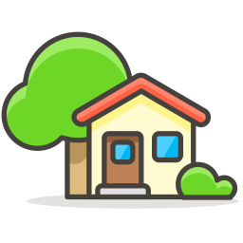
My opinion
I believe that normal house is the best and that living in tree house would be interesting experience.
Every house is special house.

Slide 6
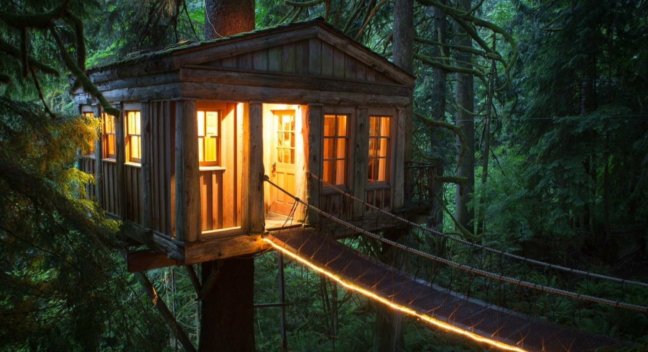
My Tree House

Slide 7
Literature
Fire: https://hotemoji.com/fire-emoji.html
Hammer: https://www.emojiall.com/bs/emoji/%F0%9F%94%A8
Storm: https://www.iconfinder.com/icons/2752495/cloud_weather_bolt_storm_lightning_icon
Snake: https://emojiterra.com/snake/
Nature: https://www.iconfinder.com/icons/2939097/common_cooking_fresh_garden_herb_leaves_sage_icon
Scream: https://www.pinterest.ca/pin/762586149382844750/
House emoji: https://iconscout.com/icon/home-803
Sparkles: https://emojipedia.org/sparkles/
Tree House: https://www.pinterest.com/pin/361132463863009363/

