Slide 1
Is it better to live in a „normal” house or in a unusual house?
David Kondres

Slide 2
A Boat house

Slide 3
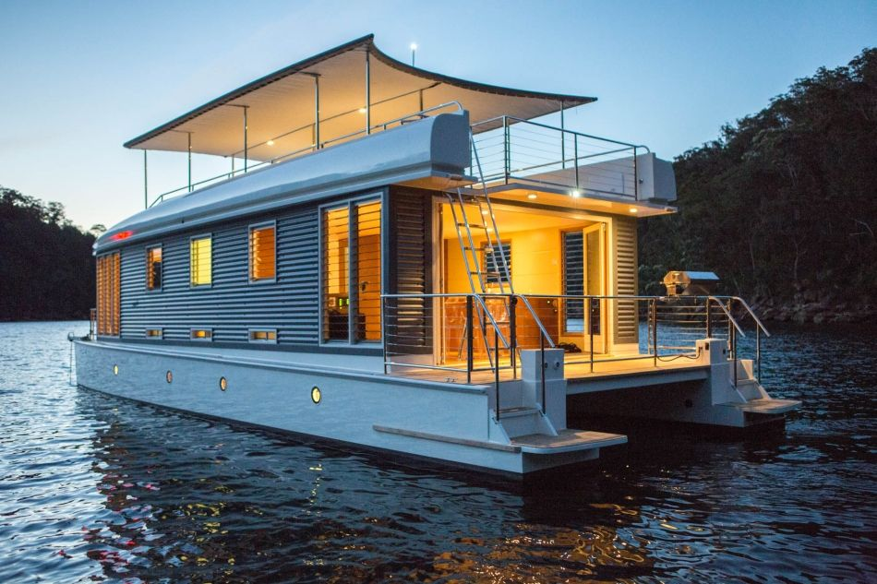
5 good things about boat-house
When I wake up, I just jump and swim.
I don’t have to fight for place on beach.
I can travel to some place and I don’t have to pack my things.
I can be in water every day.
When I go to bed, water swing me. Its easy to sleep.

Slide 4
5 bad things about boat house
It can sink.
If is uneasy weather your house shakes.
I can get attack by shark.
You can drown.
I can get my stuff in water.

Slide 5
My Opinion
It’s good to live in both houses, but I prefer boat-houses because I love boats.
Pictures are from:
https://www.pinterest.at/pin/371335931754061508/

Slide 6
Thanks for your aTtention ☺☺☺☺☺☺

