Slide 1
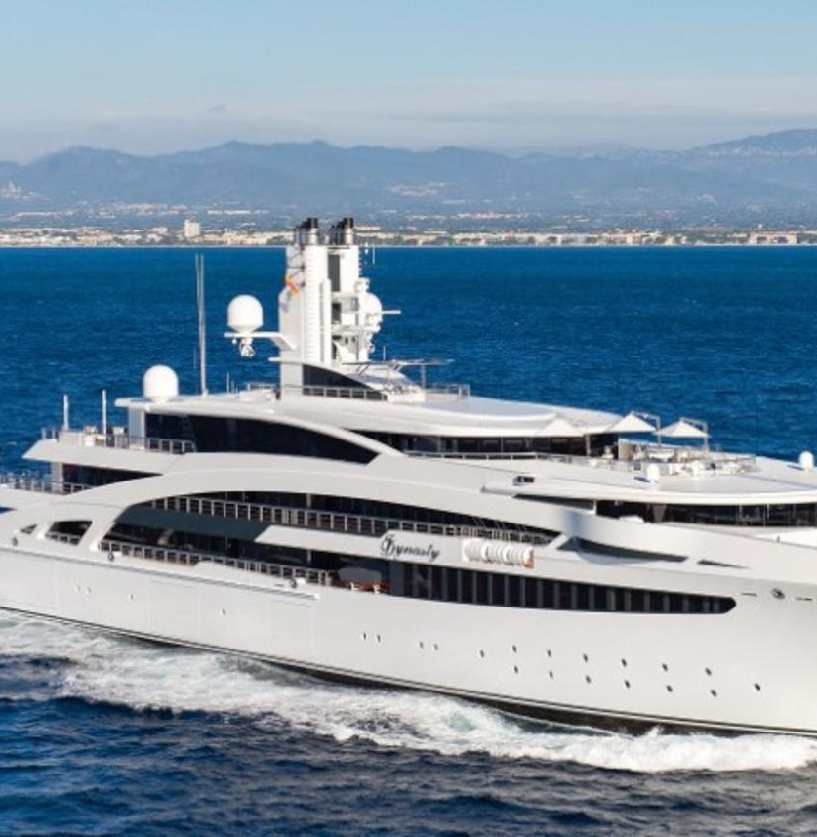
Is it better to live in normal house or unusual house?
Better is live in normal house becose have a normal life… probauly all normal house have a unusual side

Slide 2
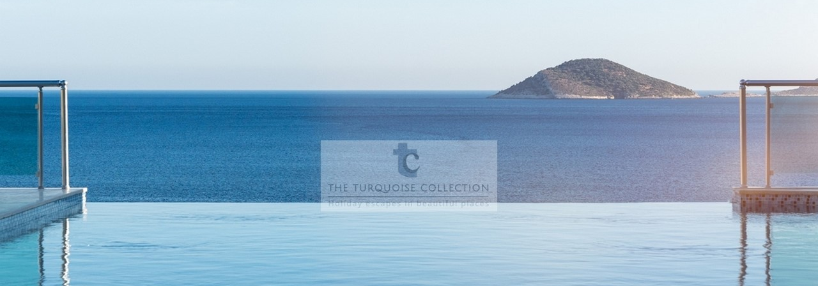
A Boat house
Boat house is better to me becose i love boats. Picture link:(https://www.theturquoisecollection.com/destinations/kalkan/kalamar/the-boat-house/

Slide 3
5 positive things about boat house
POZITIVE: - you have a long private pause from job and school - there is nice view to sea👁👃👁 - you can swimm in the sea🏊 - you can drivie all aroud the sea with boat - house🚢 - there is peace and quiet

Slide 4
5 negative things about boat house
-Boat can sink in water -Tsunami can drown you -When you svim, sharks can grab you -You can drown -you can have seasickness

Slide 5
My option
I thik is better to live in boat-house because if it drown you have reserve small boats, if tree-house start to callopse you can’t run

