Slide 1
Is it better to live in a ”normal” house or in a unsual house?
Luna Stipčić 6th grade

Slide 2
Boat-house

Slide 3
You can swim whenever you want
Fresh air all the time
No wild animals
The water pushes you around so you get to see the world
Its relaxing

Slide 4
Weaves can overflow the boat
You can get biten by a shark
The boat can sink
Tsunami can get us
You can’t gather up flowers or other nature creatures

Slide 5
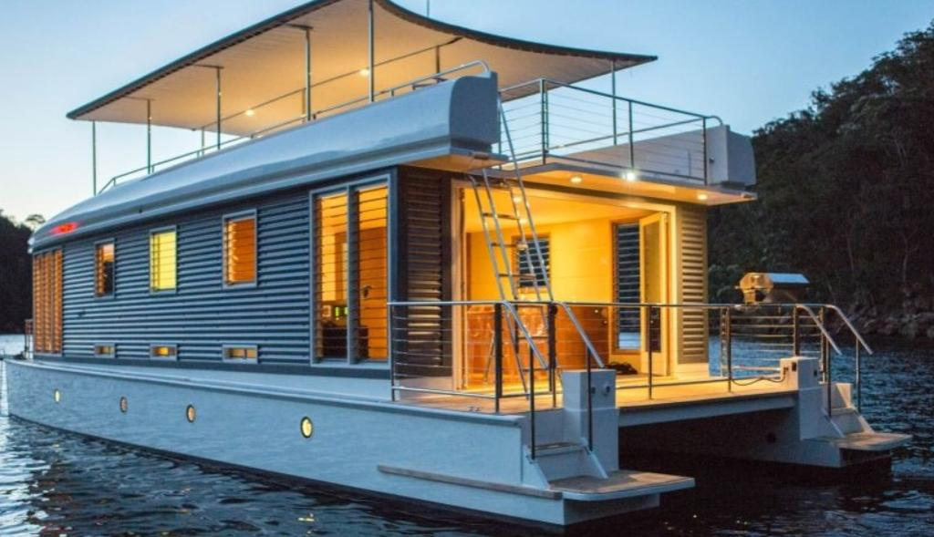
I think living in a tree-house is bad because its dangerous and not-safe.
Because we can fall,it can burn down,and wild animals can get us.
But of course thaut is just my opinion,not meant to offend anyone!😁
https://www.pinterest.at/pin/371335931754061508/

