Slide 1
Is it better to live in a „normal” house or in an unusual house?
Made by: Ella Elizabeta Pavlović

Slide 2
Tree house

Slide 3
Positive things
Live in nature
You have a quitet space
You don’t have neigbours
You can have a beautifal view
It's safe
It's good looking from outside
You can decorate it

Slide 4
Negative things
Storms can destroy the house because it's made of wood
It's hard to build it
There is no electricity
It can burn
There are many snakes

Slide 5
My opinion
It has many positive and negative things, but I would like to live there because I love nature.

Slide 6
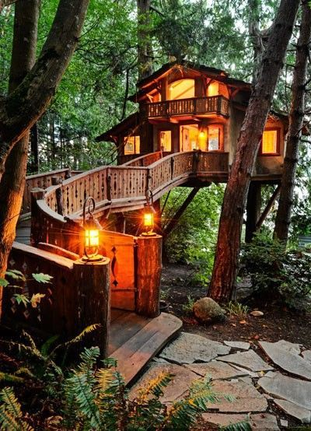
My tree house

Slide 7
Where I found a picture:
Link: https://www.mclpaya.org/ultimate-tree-house-plans/

